Slide 1
Multi-Robot Persistent Coverage Under Fuel and Stochastic Failure Constraints
Yaşar İdikut, Camden Cummings, Samara Holmes
Notes:
This PowerPoint Template includes a series of slide masters with predefined layouts and color schemes for formatting slides
Slide Masters are displayed when you right click on a slide and select Layout from menu

Slide 2
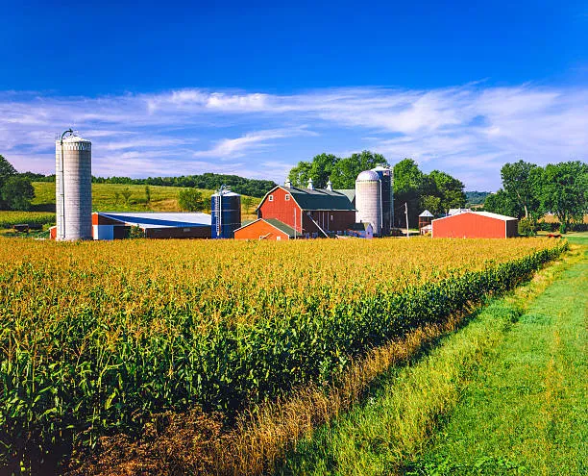
Our Problem - Agricultural Robotics
Goal: survey a field using a multi-robot system under some constraints
persistency
fuel constraints
failures
Notes:
intro + agricultural robotics interesting problem
Remove two bullets no jargon, include picture of robots
1 min - Samara

Slide 3
How Have People Solved Previously
Sycara et al., 2015 - Multi-Robot Persistent Coverage
fuel constraints while operating over long periods (but no failures)
no real robot testing
Tokekar et al., 2021
fuel and failure constraints (but not operating for large periods of time)
no real robot testing
 | Failures | Fuel Constraints | Persistence | Real World Tests
Sycara et al., 2015 | No | Yes | Yes | No
Tokekar et al., 2021 | Yes | Yes | No | No
Our solution | Yes | Yes | Yes | Yes
Notes:
only partial solutions exist, some dont include failures, some aren’t persistent, emphasize we test on robots

Slide 4
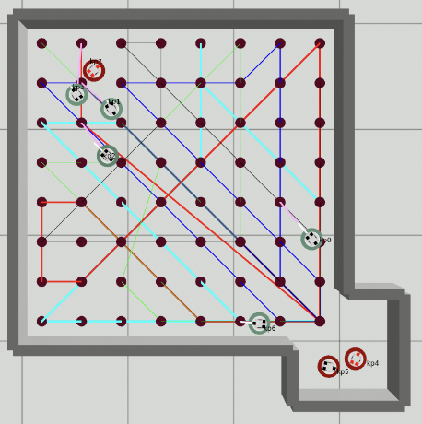
Problem: Persistent Coverage + Failures
The problem at hand is as follows:
Consider K robots, each with
surveillance radius R
fuel capacity L
constant probability rate of F to fail.
Given a square field with a side length of D, maximize the coverage of the arena.
We have multiple ways to evaluate the coverage of the arena.

Slide 5
Problem Formalization
3m
This is an NP-hard problem, where for the following parameters:
K = 8
R = 0.27m (maps to 64 nodes)
D = 3m
L = 8.49m
There are 2^{8x64x64} ~ 10^{108,852} configurations!
Hence, we propose
MILP-based formulation
Two Heuristic-based methods
Then, validate them using
Point-mass-based simulation
Physics-based simulation
Real robots
3m
8 Nodes/Axis
Notes:
mention heuristic

Slide 6
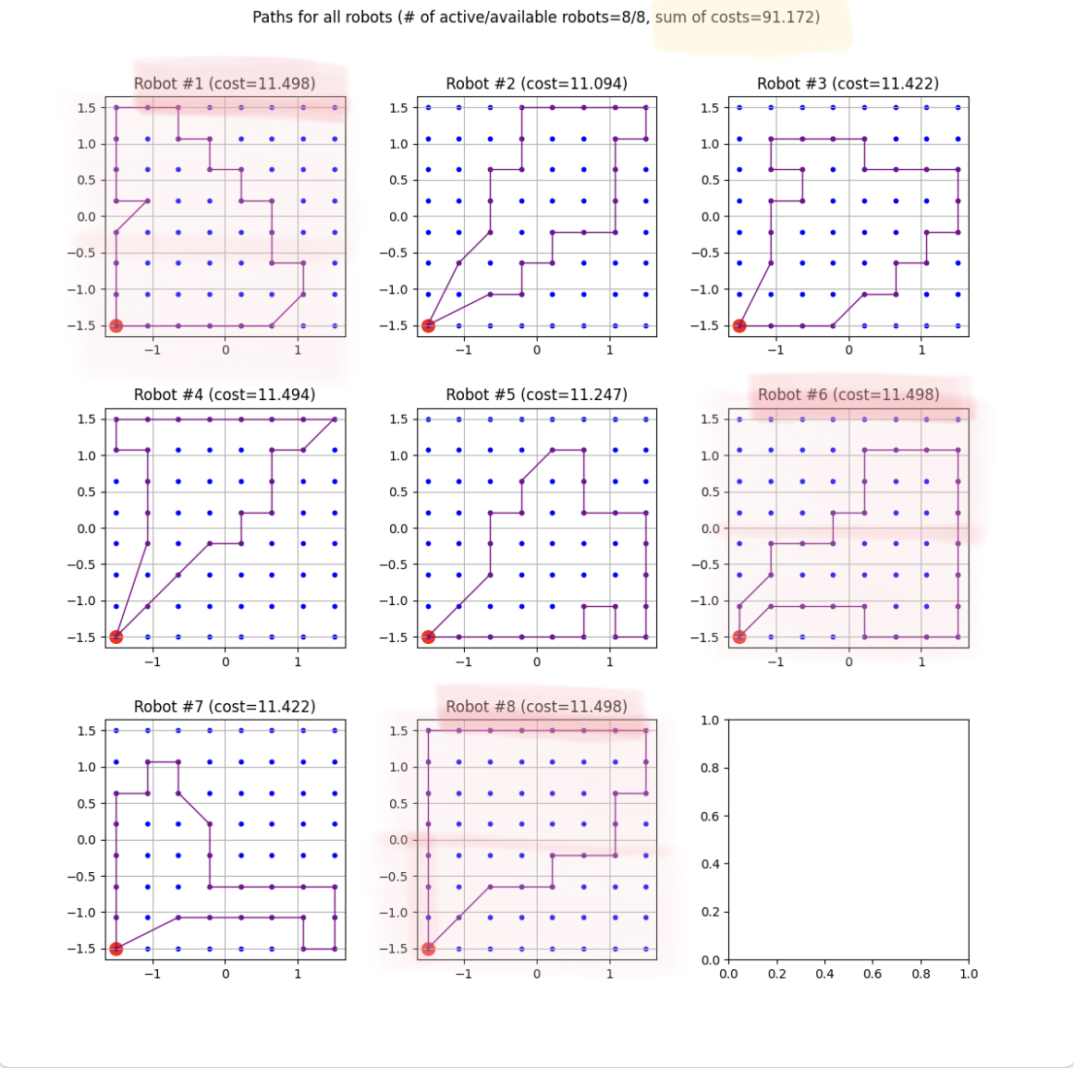
Solver: MILP(Mixed-Integer Linear Programming)
Based on the MILP formulation of a similar problem by the group of Sycara et al. (2015)
We extend on their work by:
Allowing for each node to be visited multiple times
Implementing a post-processing pipeline that reduces the total robot fleet cost
Notes:
mention what milp is

Slide 7
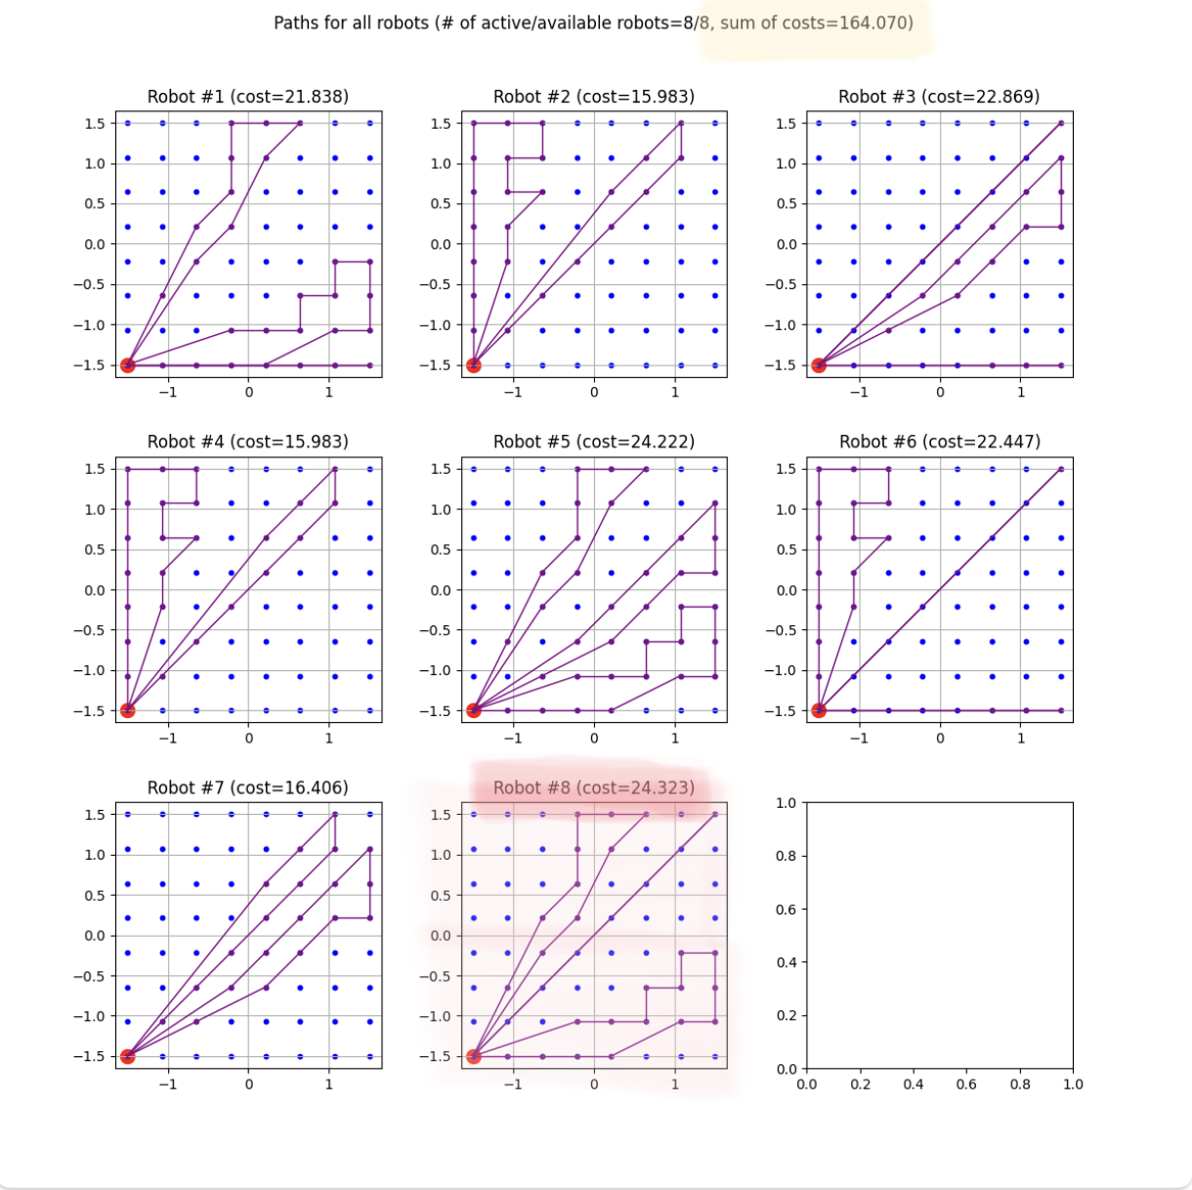
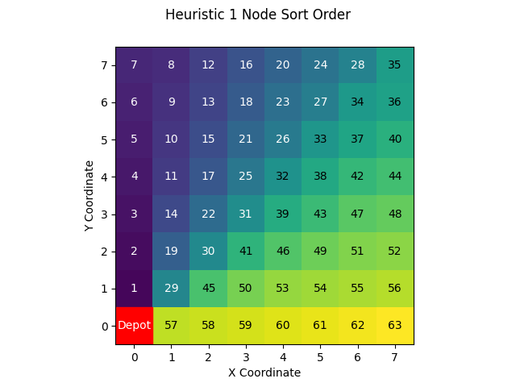
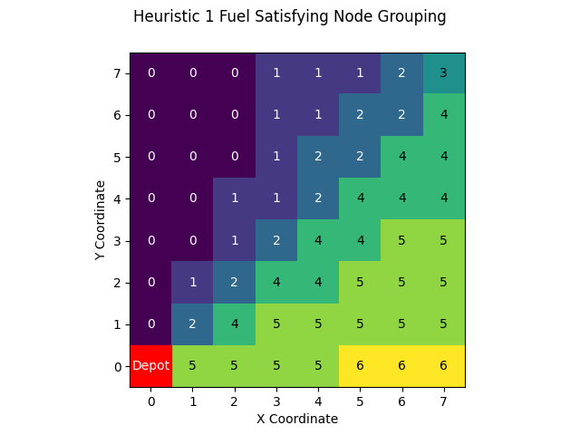
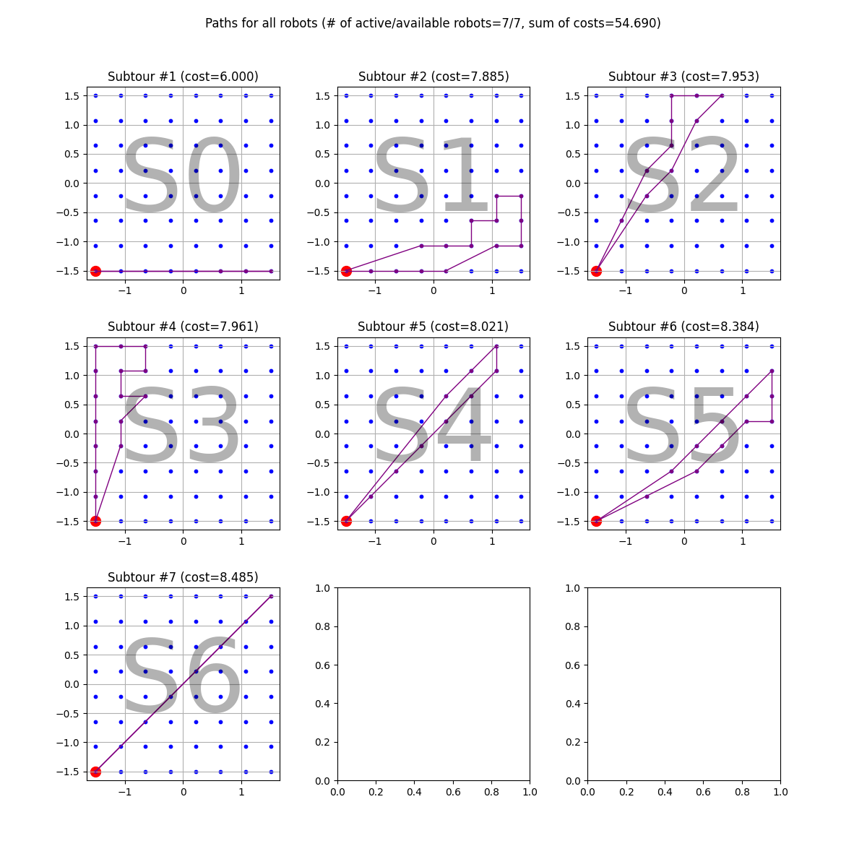
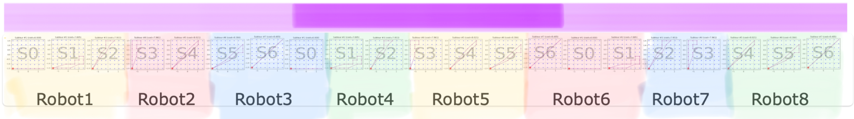
Solver: Heuristic 1
This heuristic was developed as a drop-in replacement for MILP with a similar objective
SubtoursCopy1
SubtoursCopy2
SubtoursCopy3
Notes:
animation? simplify

Slide 8
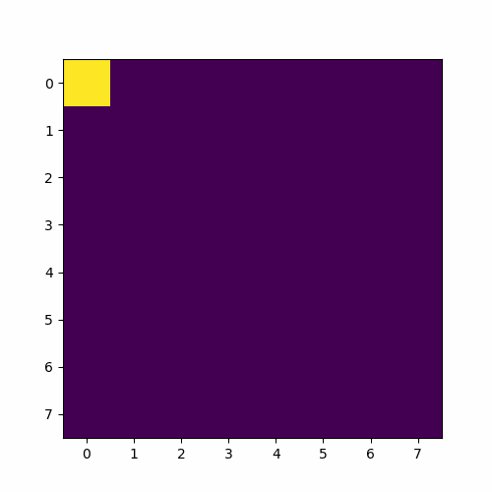
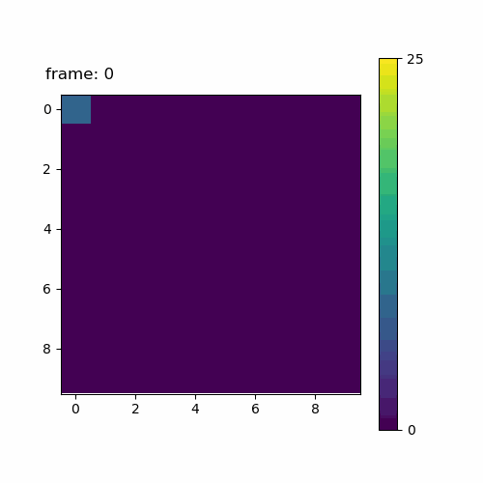
Solver: Heuristic 2/Recalc
Real time algorithm to choose nodes - No set paths chosen at the start which need to be recalculated in event of failure
Algorithm preferences: unvisited nodes and nodes that are far away
Notes:
simplify

Slide 9
Demo

Slide 10
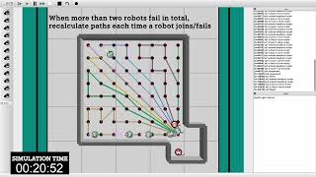
Demo

Slide 11
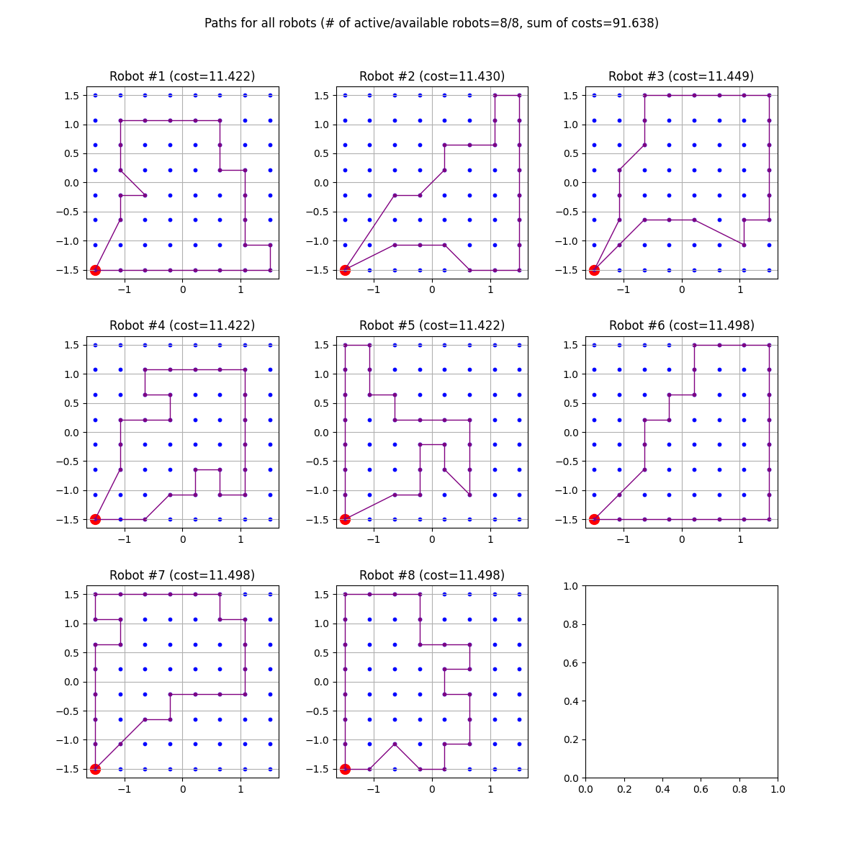
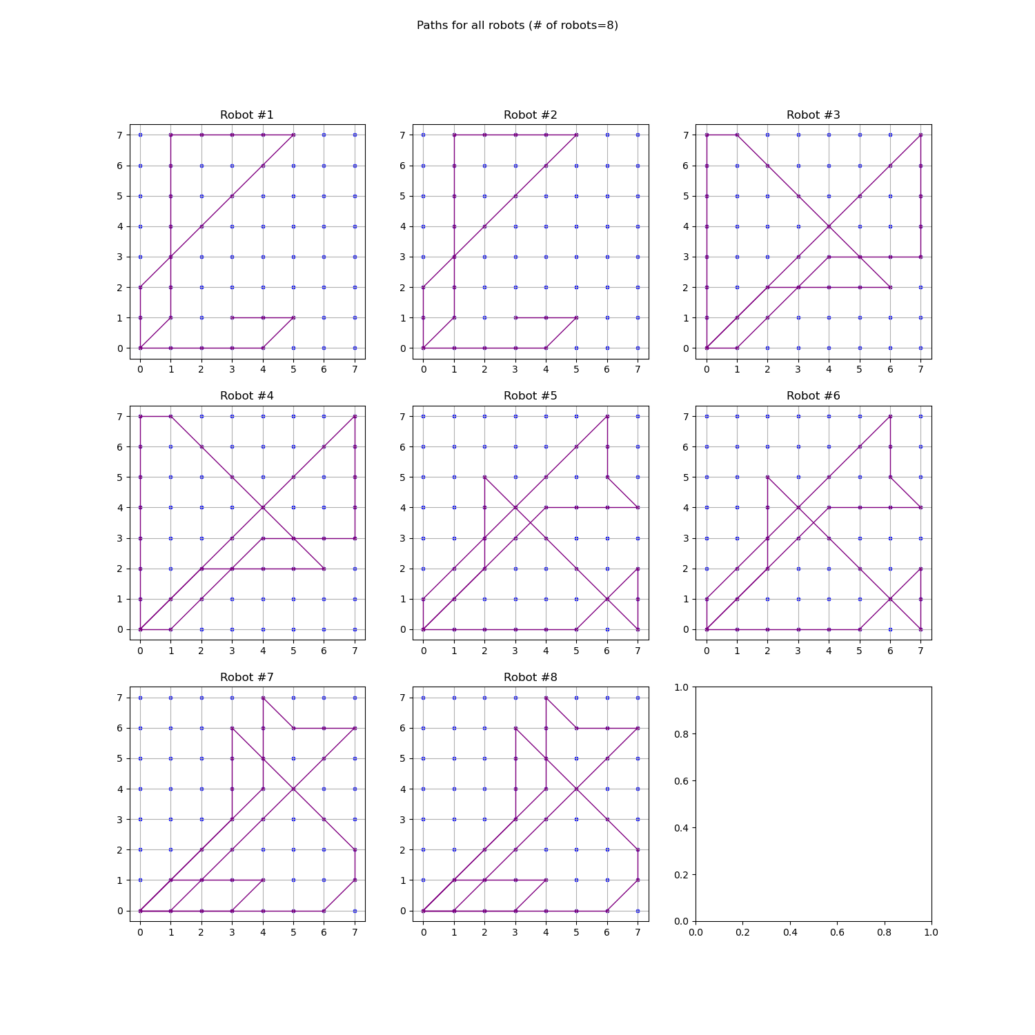
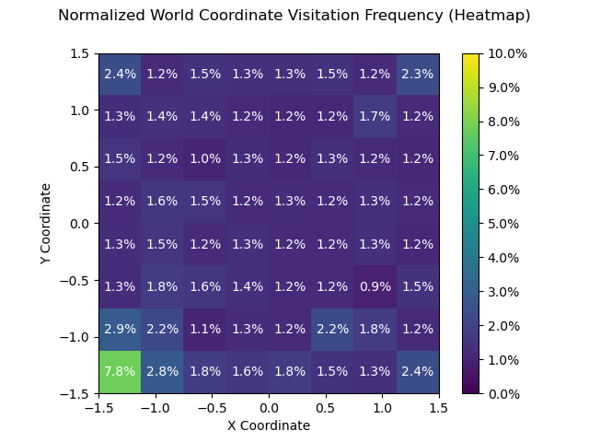
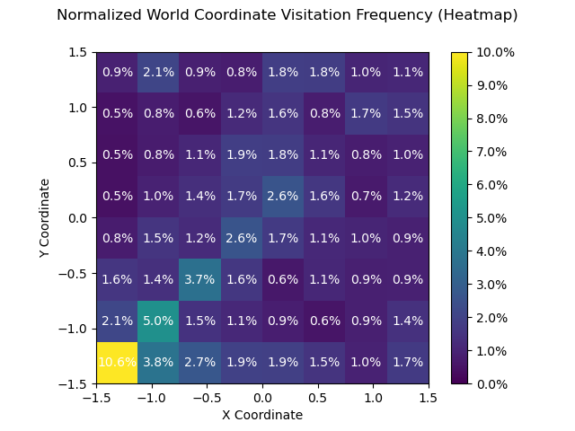
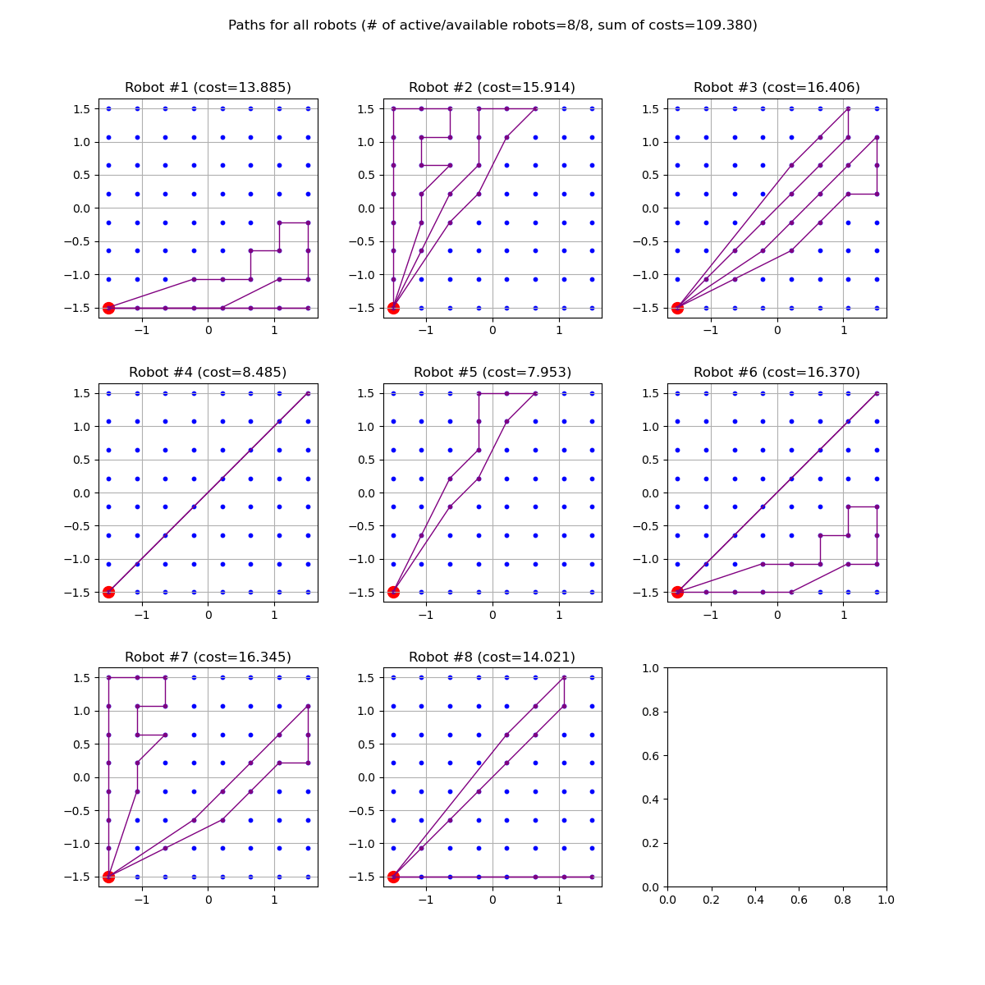
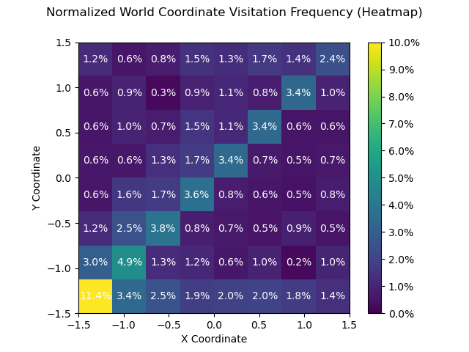
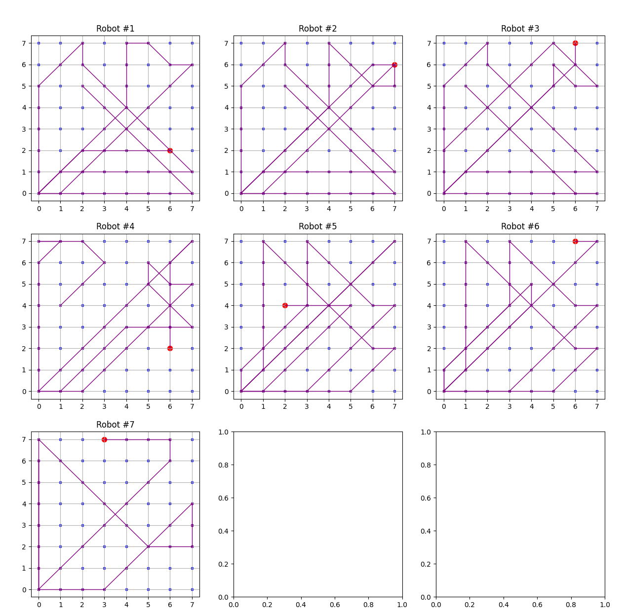
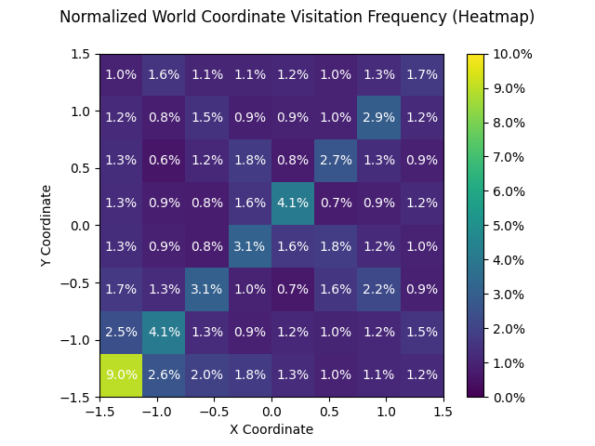
Results: Visitation Frequency and Paths
MILP provides a more uniform visitation frequency (but takes longer to run)
Visitation Frequency
Visitation Frequency
Paths
Paths
MILP (Baseline)
Heuristic 2
MILP + Recalc
Heuristic 1
Notes:
these are results we get, are they similar to previous (dan’s graphs, short comments on visitation frequency around depot for each env, method, comparison of methods and solvers)
2 mins Cam/Samara
(all maps/visit freq/%coverage/etc.)

Slide 12
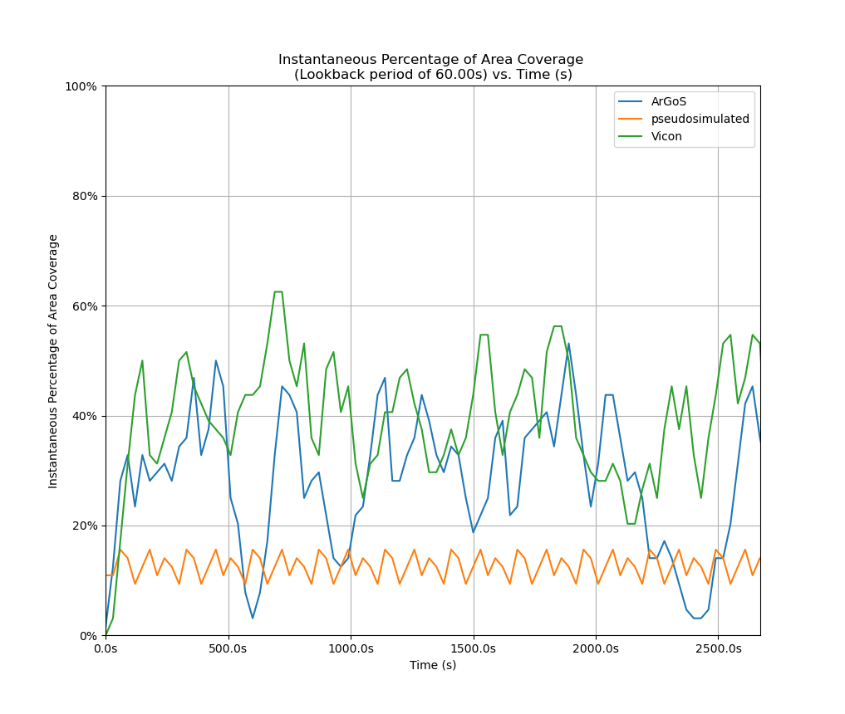
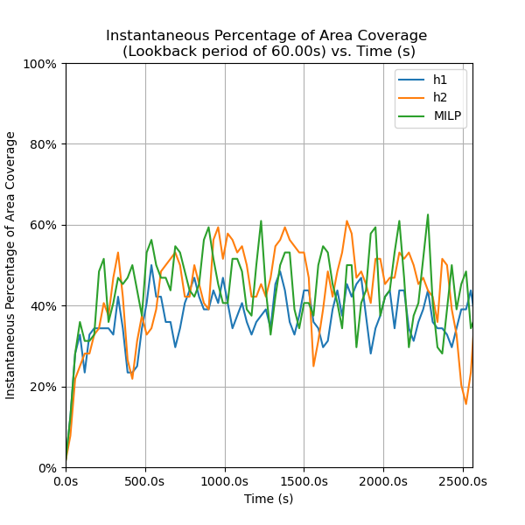
Results: Comparison of Coverage
Environments
Solvers
Notes:
these are results we get, are they similar to previous (dan’s graphs, short comments on visitation frequency around depot for each env, method, comparison of methods and solvers)
2 mins Cam/Samara pure point mass (no collisions), physics sim (collisions), real-world
(all maps/visit freq/%coverage/etc.)

Slide 13
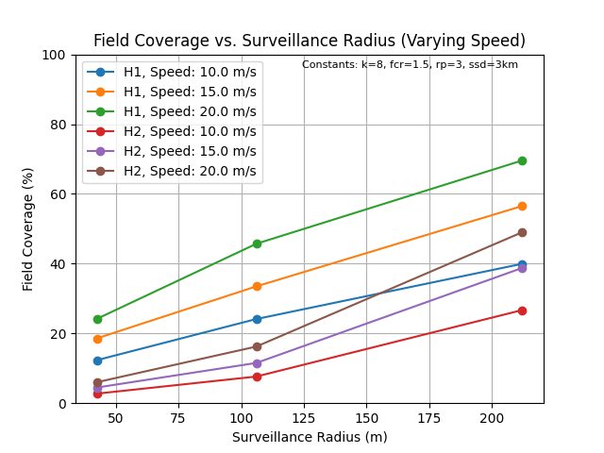
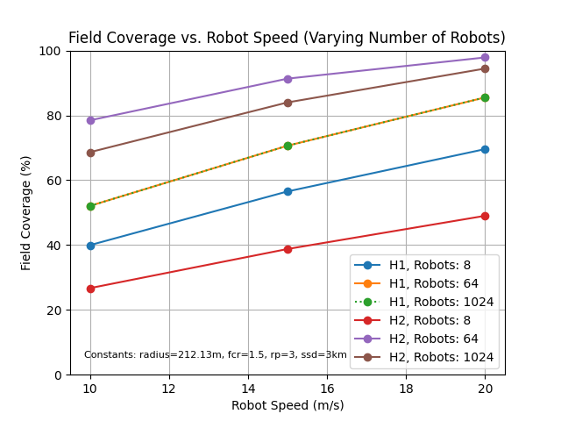
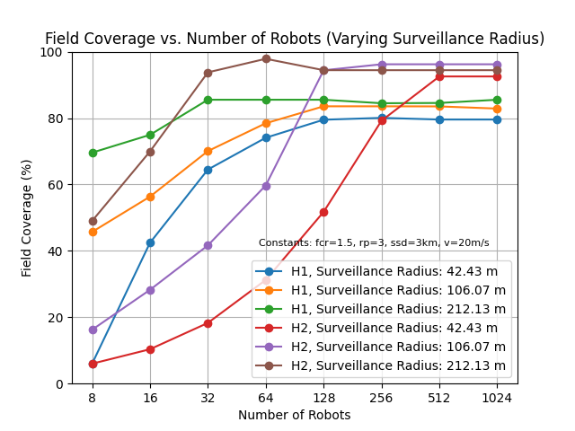
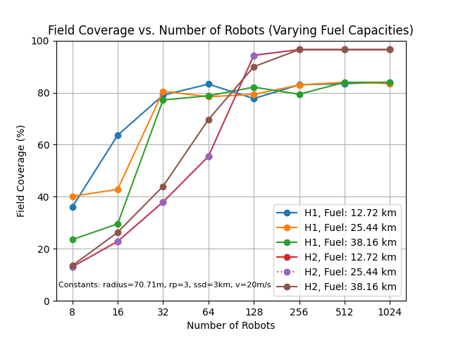
Results: Various Graphs of Coverage (H1, H2)
Graphs varying speed, surveillance radius, number of robots, and fuel limits
Heuristic 2 works better for more robots (>64)
Field coverage increased as
surveillance radius increased
speed increased
number of robots increased
These algorithms are scalable and account for failures
Notes:
these are results we get, are they similar to previous (dan’s graphs, short comments on visitation frequency around depot for each env, method, comparison of methods and solvers)
2 mins Cam/Samara
(all maps/visit freq/%coverage/etc.)

Slide 14

For more details, please visit
https://wpi-nest-lab-bae-mqp-2023.github.io/

Slide 15
Extra Slides
Notes:
This PowerPoint Template includes a series of slide masters with predefined layouts and color schemes for formatting slides
Slide Masters are displayed when you right click on a slide and select Layout from menu

Slide 16
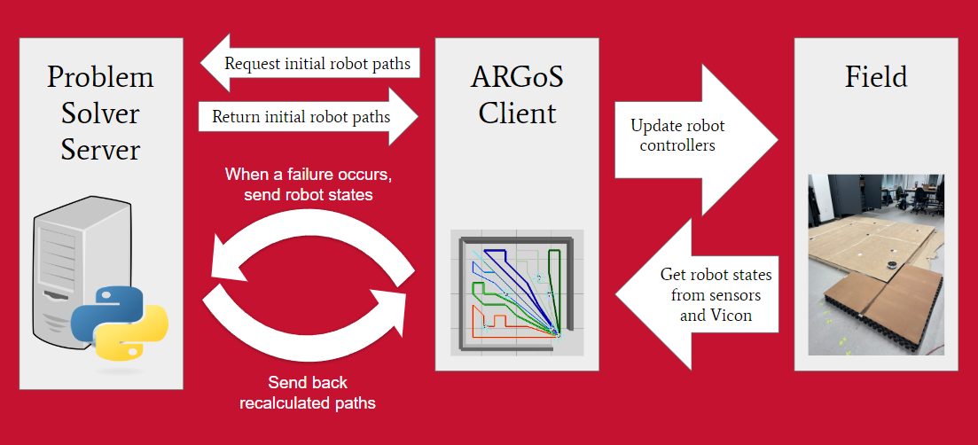
Architecture
Python server to run automated tests and generate visualizations
ARGoS Client pulls from server to gather paths and run them on the simulated robots
The field uses Vicon and ARGos paths to move the robots on the field
Notes:
architecture - Samara (1min)

